Slide 1
Covid Long Haulers Needs Assessment
Breathe California
English version : https://www.surveymonkey.com/r/T6TQL5V
Spanish version: https://es.surveymonkey.com/r/THRR6FY

Slide 2
COVID Long Haulers Needs Assessment Survey
Online, confidential survey that asked questions about COVID-19 long haulers (individuals facing post COVID-19 symptoms for weeks or months after first contracting the virus). The purpose of this survey was to inform Breathe California whether there is a need in the greater Bay Area to provide specific support services for COVID-19 long haulers.
Date Created: Thursday, June 10, 2021
Complete Responses: 66

Slide 3
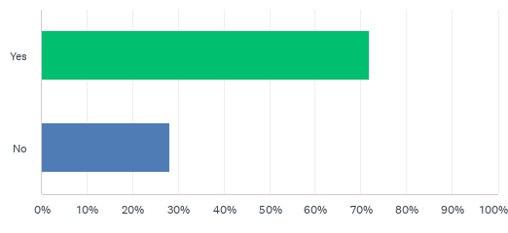
Q1: Have you or someone you know tested positive for COVID-19?
Answered: 64 Skipped: 2
A large majority of people (72%) have tested positive for Covid-19 or know someone who has tested positive

Slide 4
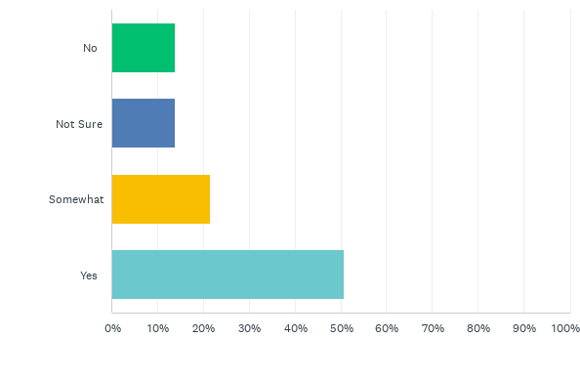
Q2: Do you have a good understanding of what a COVID long-hauler is?
Answered: 65 Skipped: 1
Although Long Covid is a confusing topic, 50% of respondents said that they had a good understanding of what a COVID long-hauler is.

Slide 5
Provided description of Long Covid
A COVID-19 long hauler is a person who has not fully recovered from COVID-19 for weeks or even months after the onset of symptoms. Mild or moderate COVID-19 lasts about two weeks but COVID long haulers experience lingering health problems even when they have recovered from the acute phase of the illness. This may also be referred to as Post-COVID Syndrome, Long-term COVID, and Post-acute sequelae of SARS-CoV-2. Long hauler symptoms can include: Most Common - fatigue, headache, shortness of breath, cough, joint pain and chest pain Less Common - cognitive problems, difficulty concentrating, depression, muscle pain, rapid heartbeat

Slide 6
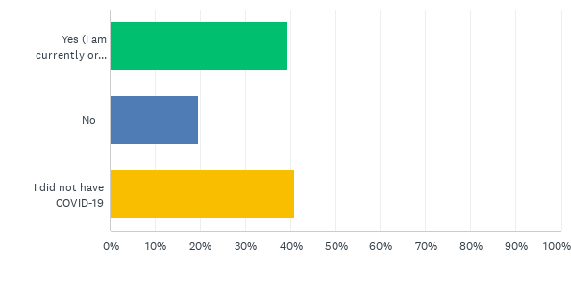
Q3: After reading the above description, have you experienced these COVID-19 long hauler symptoms?
Answered: 66 Skipped: 0
40% of respondents have experienced Long Hauler symptoms while 60% have not experienced symptoms or did not test positive for COVID-19

Slide 7
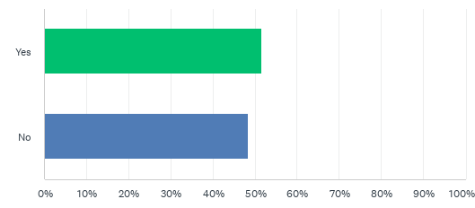
Q4: Did someone you know experience these COVID-19 long hauler symptoms?
Answered: 66 Skipped: 0
51% of respondents know someone who experienced or is currently facing Long Covid symptoms

Slide 8
Common Concerns from Respondents
With the so many missed cases in the early stages of the pandemic, many respondents were concerned about finding a true diagnosis for new health problems.
“Although I never had a positive test, I believe I may have had the disease. I am 73 and had previous breathing issues. I now seem to be experiencing constant aching joints and shortness of breath”
“I have severe fatigue, muscle fatigue, shortness of breath, chest tightness, and much more”
“Advice for individuals that did not confirm a COVID diagnosis but suspect that they are suffering from this”

Slide 9
Additional Comments
”Post viral sickness has been around a long time, it's just getting awareness now because it's more prevalent”
The biggest problem that my loved ones with long-haul covid are experiencing is cognitive difficulty. Resources for them would need to be very easy to access and understand in order to help”
Long Covid can contribute to vaccine hesitancy because people may attribute symptoms to the vaccine
“I had symptoms (joint pain, extreme lethargy) for 4.5 months after getting my second vaccine”

Slide 10
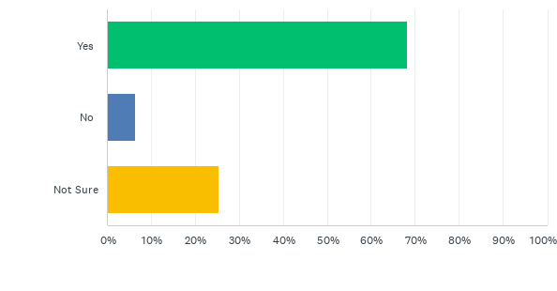
Q5: Do you think a Breathe California webpage that provides local resources and information related to COVID Long Haulers would be helpful?
Answered: 63 Skipped: 3

Slide 11
Q6: Would you visit this webpage to learn more about COVID Long Haulers and potential ways to treat long-term symptoms?
Answered: 63 Skipped: 3

Slide 12
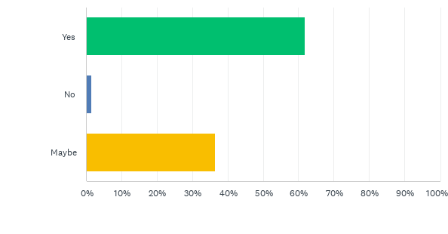
Q7: Do you think this webinar would be helpful for people experiencing COVID long haul symptoms?
Answered: 63 Skipped: 3

Slide 13
Resource Questions Summary
70% of respondents said that a Breathe California webpage with Long COVID information and resources would be helpful, and that they would visit this website to learn more about Long COVID.
62% of people responded that a webinar with healthcare professionals to present information and answer questions about long COVID would be helpful for those facing long COVID symptoms, but far fewer would personally attend.

Slide 14
Final Findings
Notable statistics from respondents:
40% have personally experienced Long Covid symptoms
60% know someone who experienced Long Covid symptoms
50% of respondents said they have a ”good understanding” of what a Covid long-hauler is
70% of people think a webpage with Long Covid information and local/online resources would be helpful and would personally visit it

Slide 15
Next Steps
Based on responses, Breathe California decided to conduct a thorough review of available resources and post easily accessible links on the Breathe California web page. Due to decreased interest for a live webinar, we posted a collection of videos that individuals can watch on their own time. These videos discuss Long Covid basics, breathing exercises, how to boost your immune system, and other topics from medical and public health professionals
Link to Breathe California Long Covid website:
https://www.lungsrus.org/long-haul-covid-19/

Slide 16
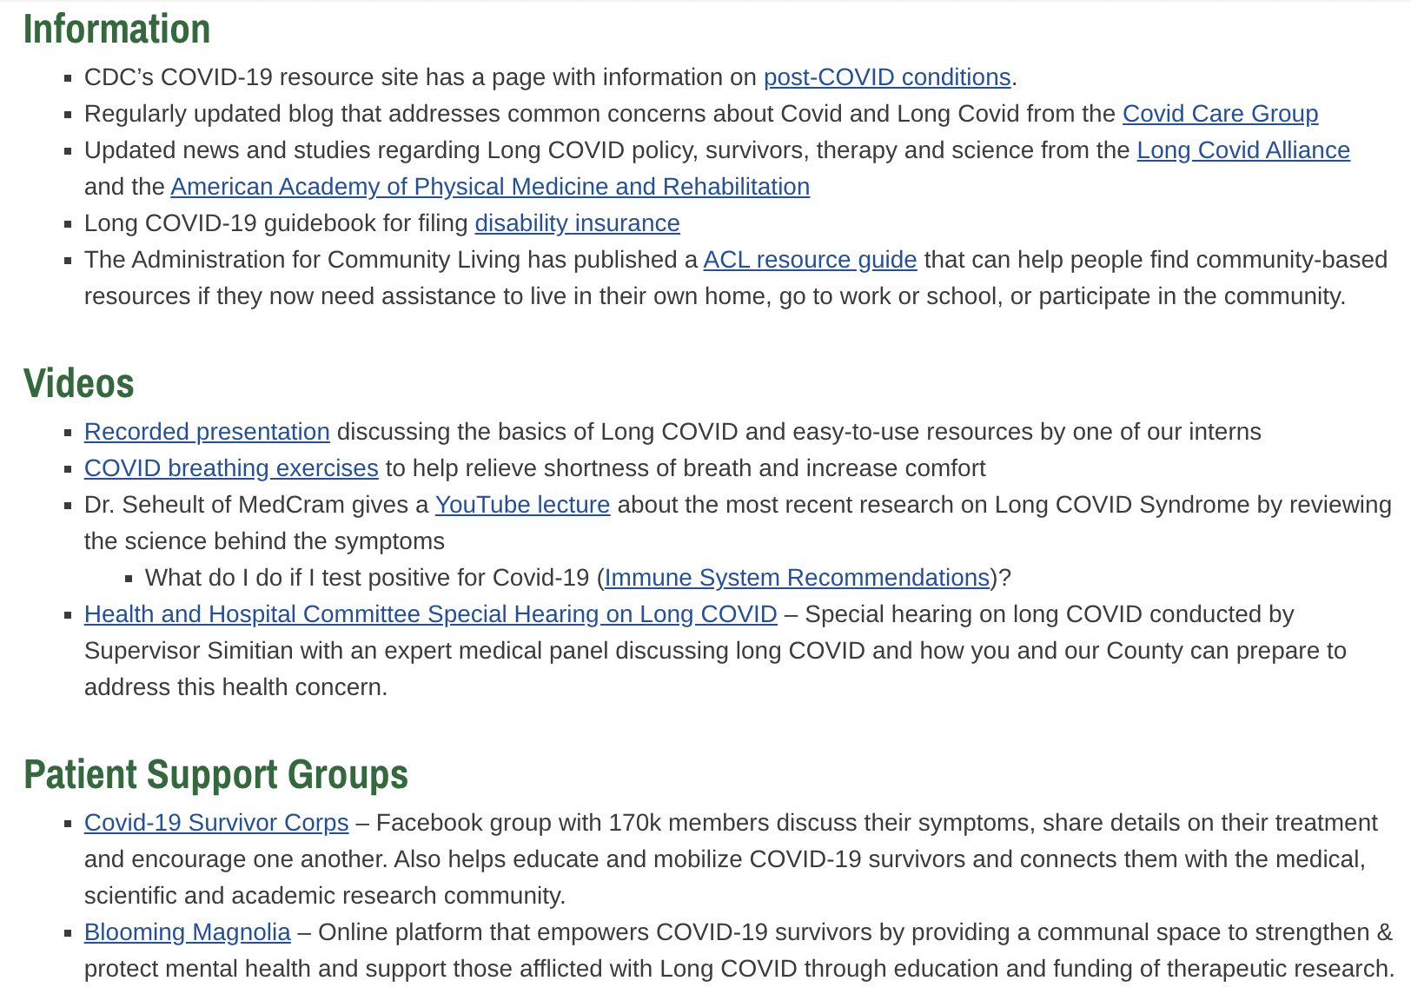
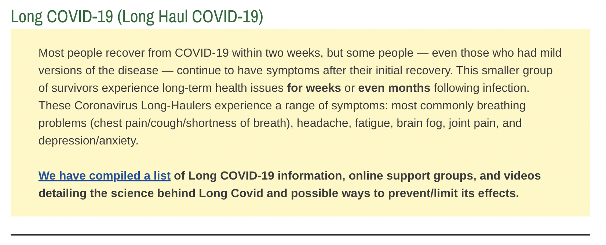
Breathe California Long Covid-19 website

